Slide 1
STUDENT NAME : HEMAMALINI NR
REGISTER NO : 312216772
DEPARTMENT : BCOM (ACCOUNTING AND FINANCE|)
COLLEGE : SHRI KIRSHNASWAMY COLLEGE FOR WOMENS

Slide 2
PROJECT TITLE
EMPLOYEE PERFORMANCE ANALYSIS USING EXCEL

Slide 3


AGENDA
Problem Statement
Project Overview
End Users
Our Solution and Proposition
Dataset Description
Modelling Approach
Results and Discussion
Conclusion
3/21/2024 Annual Review

Slide 4

PROBLEM STATEMENT
. In a contemporary business environment, organizations need to effectively monitor and enhance employee performance to ensure productivity , engagement and overall success.
. The company will analysis the employees attendance , work performance.

Slide 5

PROJECT OVERVIEW
. The primary objective of this project is to develop a performance analysis system that provides a comprehensive , data driven evaluation of employee performance.
. This system will enhance the accuracy , fairness and effectiveness of performance reviews , ultimately improving employee productivity and organizational outcomes.

Slide 6
WHO ARE THE END USERS?
In an employee performance analysis project, the following are potential end users:
HR Department
Managers and Supervisors
Employees
Training and Development Team
Compensation and Benefits Team
Succession Planning Team
Analytics and Reporting Team

Slide 7

OUR SOLUTION AND ITS VALUE PROPOSITION
Our solution and its value techniques are used in pivot table , conditional format and formulas , etc . We can arrange the table as rows and columns of the employee performance.
conditional formatting : To highlight missing values
pivot table : To summaries the employee data
formulas : To find out performance level of employee

Slide 8
Dataset Description Dataset - Downloaded using kaggle 26 features but used 9 Features - Employee id ,first name, last name , performance level , gender, employee rating, employee type ,active status , etc

Slide 9

THE "WOW" IN OUR SOLUTION
Data collection:
Downloaded using kaggle
Features collection:
Employee id
First name
Last name
Gender
Employee performance level
Data cleaning:
Filled missing values and cleaned blank tabs using filters
Performance level:
Using formulas the performance level is identified.
3/21/2024 Annual Review
9

Slide 10
MODELLING
Data collection:
Downloaded using kaggle
Features collection:
Employee id
First name
Last name
Gender
Employee performance level
Data cleaning:
Filled missing values and cleaned blank tabs using filters
Performance level:
Using formulas the performance level is identified whether very high , high , medium , low
Pivot table:
Using graphs the employee performance level shown . I looks like data visualization
10

Slide 11
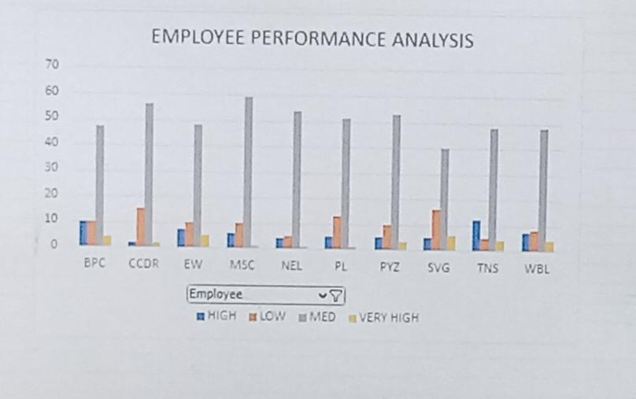
RESULTS

Slide 12
Conclusion In this dataset most of the employee performance is better . It is shown as pivot table by using column chart

